Slide 1
Chapter 1
Introduction to Neural Computation

Slide 2
Questions !
Why computers which have high computing abilities, but still
Cannot do simple things the human brain can do easily …
For example, Face Recognition, Listen and Understand Speeches
Human Brain vs Computer
Neural Cells send
Signals at rate
1000 times/s
Speed of Computer
Now at >
3000 MHz
Speed
Math
Computing
Super Computer
> 1000 MFLOP
Brain 
Memorize and
Classify
Pictures and Sounds
Brain 
Computer 

Slide 3
Human Brain
Human Brain is powerful and stable
(every day neural cells are dead)
Human Brain is flexible (learning)
Human Brain capable of handling data with uncertainty,
noisy, unstable
Human Brain computes huge data with parallel process
Human Brain is small and require little power
Human Brain structure is evolved more than million years
And still survive now

Slide 4
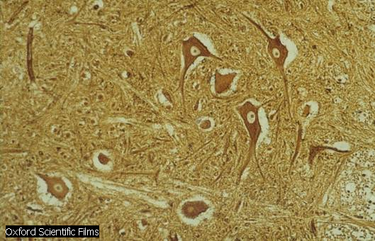
Structure of Brain and Neural Cells
Cell body (soma)
Dendrite
Nucleus
Neuron
Axon
Synapse
Myelin sheath

Slide 5
How a cell works
- Neural Cells consist of Soma, Axon and Dendrites
at the end of Axon there is a Synapse connected with Dendrites
of other cells, in which Axon and Dendrites are used to send
electrical signal between cells
Axon is longer than Dendrites (Axon may be long for 1 meter)
Axon has Myelin sheath for getting better signals
and remove noises
Axon
Myelin sheath
Soma
Dendrites
Synapse

Slide 6
How a cell works
Normally when Neuron does not work, inside the cell will have
high K⁺and Organic ion, and outside will have high Na⁺ and Cl⁻
When it is stable, the different between inside and outside the cell
makes voltage about -70 to –100 mV called Resting potential
-70 mV
−
+
Organic
ion
Cl⁻
K⁺
Na⁺
K⁺
Cl⁻
Na⁺

Slide 7
How a cell works
Electrical signals are sent via Axon and Dendrites to Soma
If there is enough signal at Soma, the concentrate of ion inside will
increase because of increasing of Na+ then making the Resting
potential decreases,
- This changing electrical signal is called Action potential
Outside signals
30 mV
+
-70 mV
+
−
+
−
+
Organic
ion
Organic
ion
Cl⁻
Cl⁻
K⁺
K⁺
Na⁺
Na⁺
K⁺
Cl⁻
K⁺
Cl⁻
+
Na⁺
Na⁺
+
Before working , Cell is stimulated
Cell sends the signals out

Slide 8
How a cell works
Action potential will be sent to the connected cells nearby
After sending the signals, cell will stop working for a while,
to wait for its inside ion being stable again, it takes about 1 mSec
In Conclusion
Brain cells have simple working functions, in which the cell gets
electrical signals from other cells to stimulate itself to send
electrical signals to other cellsใ

Slide 9
Structure of Human Brain and Computer
Brain
Brain consists of Neuron cells for about 100,000 million cells
Each Neuron cell does a simple task,
  the output signals are waves of electrical signals
Normally, each Neuron will connect with other 10,000 Neurons
Some Neural Cells may connect with 200,000 Neurons
Brain does not have a central memory, but the brain will learn
and remember by changing the structure of the brain
Brain can learn by perform over and over again until
those skills can be memorized

Slide 10
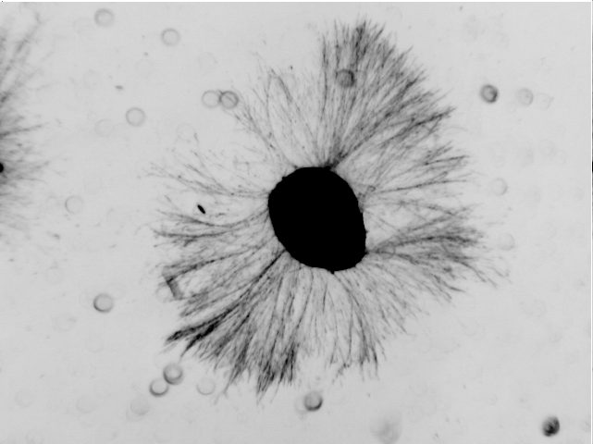
Example of neurons
⬥ The cultured retinal explants taken from chick embryos
From http://www.ams.sunysb.edu/research/pinezich/neuron_reconstruction/

Slide 11
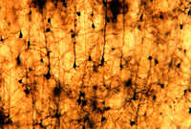
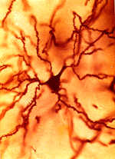
Example of neurons (continued)
⬥ Neurons located in the cerebral cortex of the hamster.
From http://faculty.washington.edu/chudler/cellpyr.html
(Image courtesy of Dr. James Crandall, Eunice Kennedy Shriver Center)

Slide 12
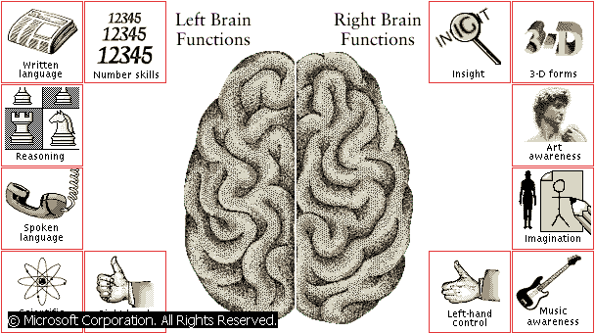
Brain Works
Scientific skill

Slide 13
Structure of Human Brain and Computer
Computer
CPU is complex and powerful , each computer has small number of CPUs
Connection between CPUs is simple.
Central Memory for store programs and data
Using Programs from instruction set to perform in sequence
What is Artificial Neural Networks?
A subject about computing by simulating the work of
human neural network

Slide 14
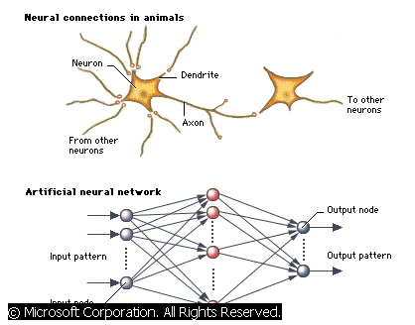
Artificial Neural Networks
Copy the structure of cells of neural by using huge numbers
of simple process connected into a network

Slide 15
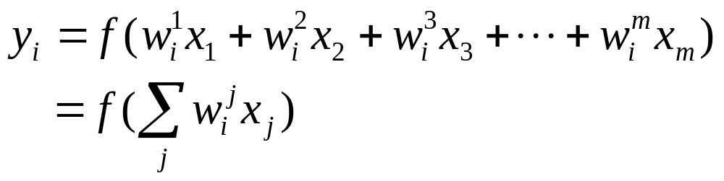
An Example
Input nodes
Output nodes
Hidden nodes
Connections
Output for each node
X_{i} = input from other nodes
W_{i}^{j} = weight for each connection

Slide 16
ANN and Computer
- ANN use concentrating on structure of network of simple process
Computer uses high performance CPU with small numbers
Computer executed by programs
ANN trained by Training set
Adjusting weight of connections to get minimum training error
adjusting weight slowly the error will reduced over time
Normally Simulations are used, the hardware ANN is rarely used

Slide 17
Using ANN
Recognition
2. Black Box ---find relationships between inputs and outputs
3. Changeable environments
4. Classifications
5. Predictions

Slide 18
Neural Network Taxonomy
Decoding
Feedforward
Feedback
Gradient Descent
Least mean square
Backpropagation
Reinforcement learning
Supervised
Recurrent Backpropagation
Encoding
Vector Quantization
RABAM
Brownian annealing
Boltzmann learning
ABAM, ART-2, BAM
Unsupervised
Self-organizing maps
Competitive learning
Counter-propagation
Adaptive Resonance
ART-1, ART-2

Slide 19
Types of Learning
1. Supervised Learning
Training data will have expected answers to measure
the errors for adjust the weights inside the network
2. Unsupervised Learning
No answers to measure the outputs, the network will
Rearrange its structure by itself according to received data

Slide 20
Network Architecture
Feedforward network
Processed data inside the network are sent in the same direction
From input nodes through the inside network until reaching
output nodes without flowing data back
even no connection between nodes inside the same layer
Direction of data flow
Input nodes
Output nodes

Slide 21
Network Architecture (cont.)
Feedback network
Processed Data inside the network will be feed back
to the network many times until getting the solution
(sometimes called Recurrent network)
Input nodes
Output nodes

Slide 22
Chapter 2
Single Layer Perceptron Networks

Slide 23


How can we use a mathematical function to classify ?
⬥ Consider a simple problem: How can we classify fat and
thin peoples?
Thin
Height
(cm.)
Decision line
Fat
180
140
40
80
Weight (kg.)

Slide 24
How can we use a mathematical function to classify ? (cont.)
⬥ We used 2 inputs, weight (x₁) and height (x₂),
to classify “thin” and “fat”.
Thin
x₂
(cm.)
Decision line
Fat
180
Area where
x₂ - x₁ - 100 > 0
⬥ We can use
a line to classify
Data.
Line x₂ - x₁ - 100=0
Area where
x₂ - x₁ - 100 < 0
140
40
80
x₁ (kg.)
Weight-height space

Slide 25
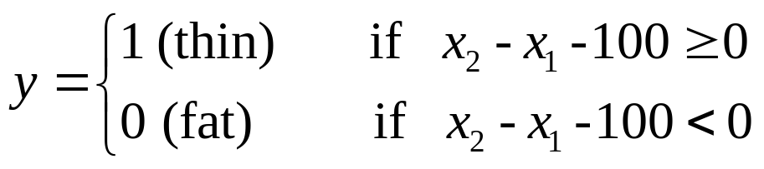
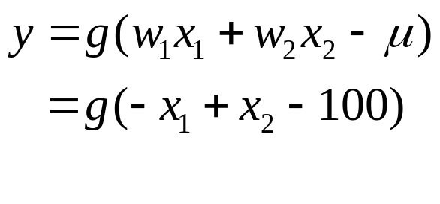
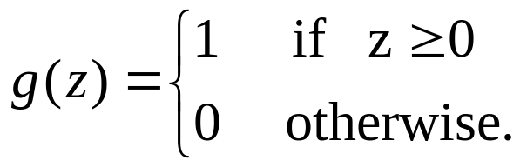
How can we use a mathematical function to classify ? (cont.)
⬥ We can write the decision function for classifying
“thin” and “fat” as follows:
or
where
Advantage: Universal linear classifier
Problem: For a particular problem, how can we choose
suitable weights w and μ of the function ?

Slide 26
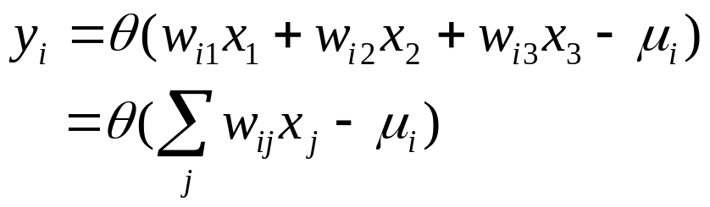
Supervised Learning: Perceptron Networks
Rosenblatt and his team invent the idea of Perceptron
In 1962 inspired by the model of neural cells of
McCulloch-Pitts
x₁
w_{i1}
w_{i2}
x₂
Σ
y_{i}
w_{i3}
μ_{i}
x₃
McCulloch-Pitts model

Slide 27
Supervised Learning: Perceptron Networks (cont.)
⬥ The decision function to classify “thin” and “fat”
using the McCulloch-Pitts model:
where
x₁
-1
Σ
y
x₂
1
100

Slide 28
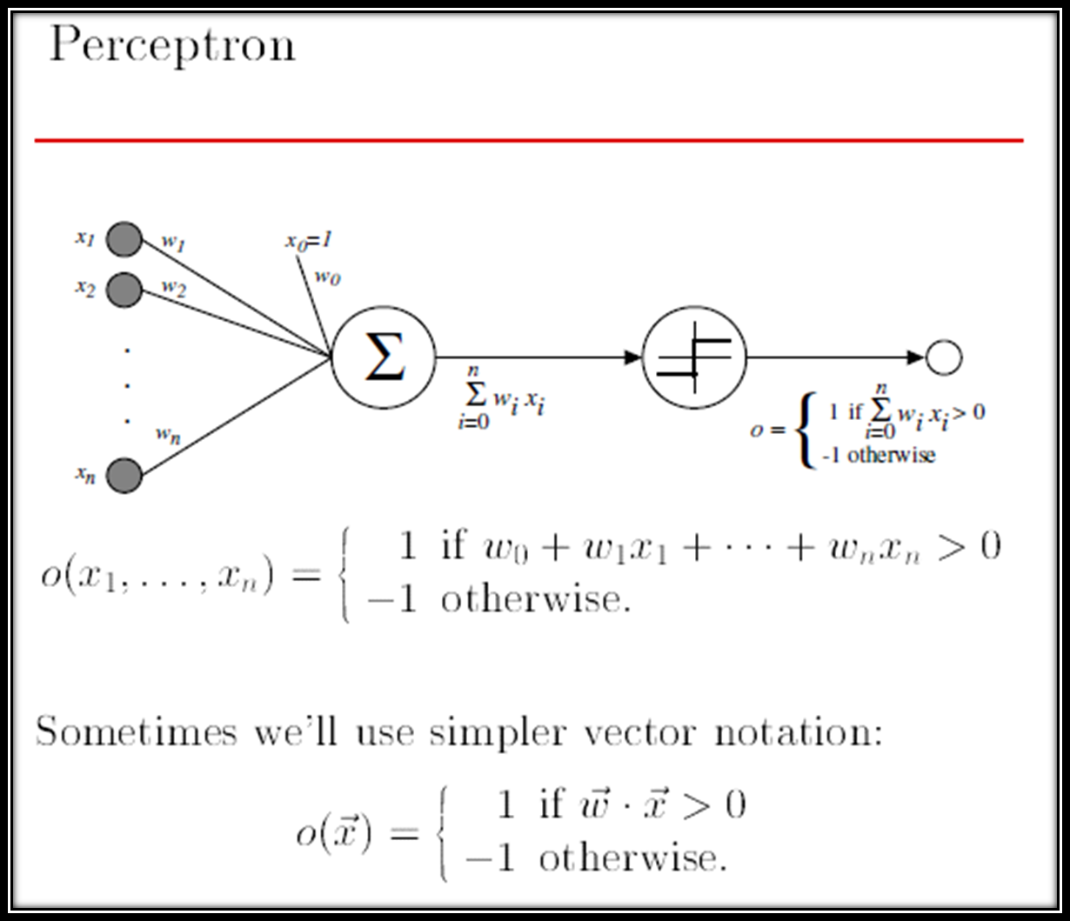

Slide 29
Perceptron Networks
Output nodes
Output nodes
Hidden nodes
Input nodes
Input nodes
Single layer percentron
network
Multilayer percentron
network
(this case: 2 layers)

Slide 30
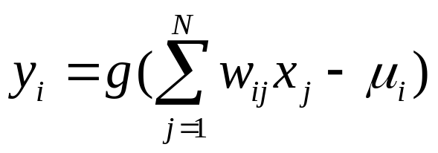
A Single Layer Perceptron Network
For each node, the output is given by
Input layer
Output layer
x₁
w_{i1}
x₂
w_{i2}
y_{i}
w_{i3}
x₃
w_{i4}
x₄
w_{ij} = Connection weight of branch (i,j)
x_{j} = Input data from node j in the input layer
μ_{i} = Threshold value of node i in the output layer
g = Activation function

Slide 31
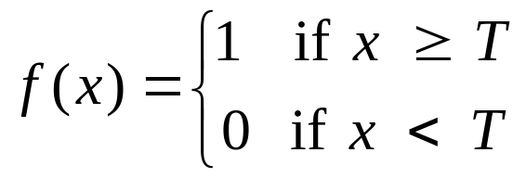
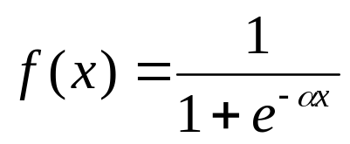
Single Layer Perceptron Networks (cont.)
The number of input nodes
depend on the number of components of input data
Activation function can be defined from the characteristic of Output
if outputs are either “yes” or “no” we use Threshold
function
if outputs are continuous numbers, we need continuous function
as Sigmoid function
T=Threshold level

Slide 32
Activation function
Threshold function (T=0)
1.2
1
0.8
0.6
0.4
0.2
0
-0.2
-10
-5
0
5
10
Sigmoid function
1.2
1
α = 4
0.8
α = 2
α = 1
0.6
0.4
α = 0.5
0.2
0
-0.2
-10
-5
0
5
10

Slide 33
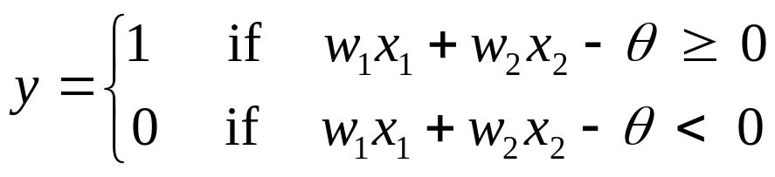

How a single layer perceptron works
Assume that we have perceptron of 2 input nodes
and activation function as threshold function
We will have Binary output
x₁
w₁
y
x₂
w₂
x₂
Region where
y = 1
line L =
- if (x₁,x₂) is over the line L, we get y = 1
- if (x₁,x₂) is under the line L, we get y = 0
So we call this line L as
Decision function or
Boundary Function
Region where
y = 0
x₁

Slide 34
How a single layer perceptron works (cont.)
Slope and Position of line L : w₁x₁+w₂x₂ – q = 0 depend on parameters w₁, w₂, and q , we have to adjust parameters for a right line
Line L has to be
in this range
for Function AND
Example
Function AND
x₁ | x₂ | y
0 | 0 | 0
0 | 1 | 0
1 | 0 | 0
1 | 1 | 1
x₂
(1,1)
y =1
(0,1)
This line is not
for Function AND
x₁
(0,0)
(1,0)
y = 0

Slide 35
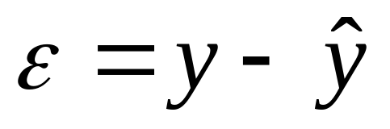



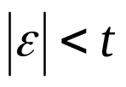
Learning Algorithm: Training Perceptron Networks
Adjusting The Networks: adjust parameters in the way to
Reduce the error
Step of Training the network
1. feed Input to Network
2. computeNetwork Output
3. compute Error
4. adjust all weights
5. do step 1 until Error
is less than a threshold

Slide 36
Learning Algorithm: Training Perceptron Networks (cont.)
Adjust weights
Error
x₁
w_{i1}
x₂
y
Network
output
-
Σ
Input
w_{i2}
w_{i3}
+
x₃
Desired output

Slide 37



Learning Algorithm: Training Perceptron Networks (cont.)
Training Perceptron Networks by adjusting weights !
Formula for adjusting weight
feeding input-output pairs for training have to be complete
1. Feed all pairs accordingly in the table or
2. Feed randomly

Slide 38
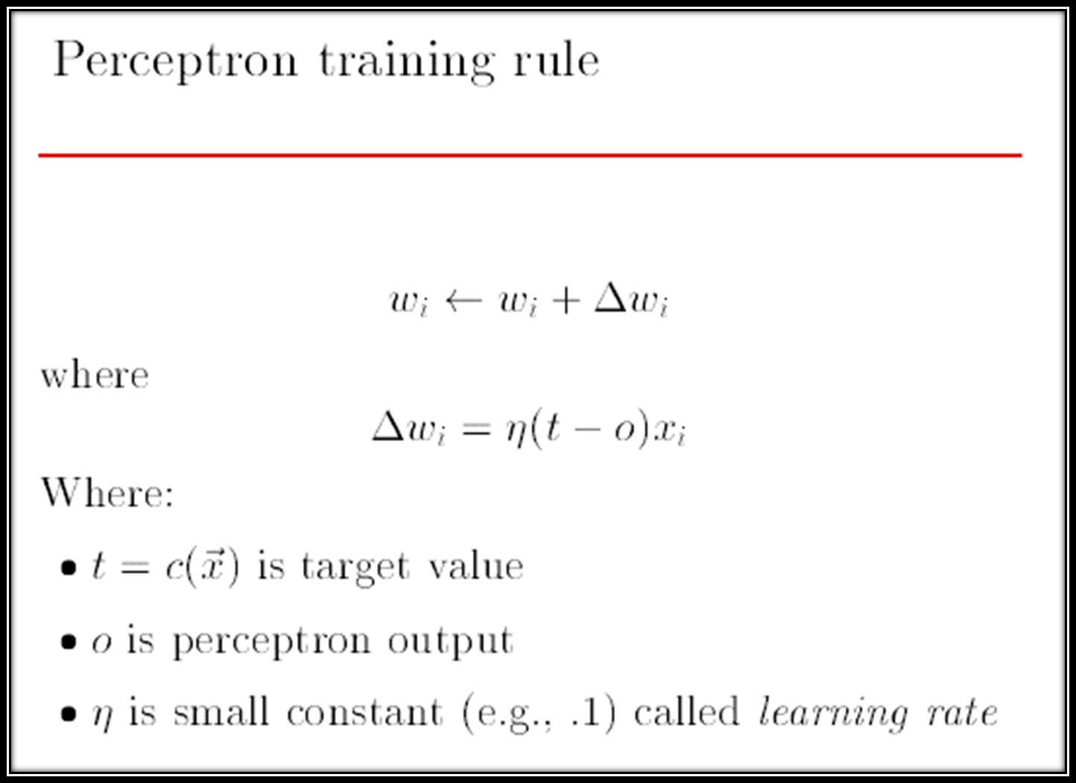

Slide 39
Learning Algorithm: Training Perceptron Networks (cont.)
Example
Function AND
x₁ | x₂ | y
0 | 0 | 0
0 | 1 | 0
1 | 0 | 0
1 | 1 | 1
Adjusting # 16
1.2
Adjusting # 12
1
Adjusting # 8
0.8
Adjusting # 4
Start
0.6
0.4
Initial Values
0.2
w₁ = 0.5
w₂ = 2.5
θ = 1.0
α = 0.2
0
-0.2
-0.2
0
0.2
0.4
0.6
0.8
1
1.2

Slide 40

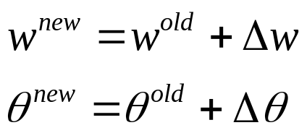
Learning Algorithm: Training Perceptron Networks (cont.)
n | x₁ | x₂ | y | y^ | Err | W₁ New | Δw₁ | W₂ New | Δw₂ | Θ New
0 |  |  |  |  |  | 0.5 |  | 2.5 |  | 1
1 | 0 | 0 | 0 | 0 | 0 | 0.5 | 0 | 2.5 | 0 | 1
2 | 0 | 1 | 0 | 1 | -1 | 0.5 | 0 | 2.3 | -0.2 | 1.2
3 | 1 | 0 | 0 | 0 | 0 | 0.5 | 0 | 2.3 | 0 | 1.2
4 | 1 | 1 | 1 | 1 | 0 | 0.5 | 0 | 2.3 | 0 | 1.2
5 | 0 | 0 | 0 | 0 | 0 | 0.5 | 0 | 2.3 | 0 | 1.2
6 | 0 | 1 | 0 | 1 | -1 | 0.5 | 0 | 2.1 | -0.2 | 1.4
7 | 1 | 0 | 0 | 0 | 0 | 0.5 | 0 | 2.1 | 0 | 1.4
8 | 1 | 1 | 1 | 1 | 0 | 0.5 | 0 | 2.1 | 0 | 1.4
9 | 0 | 0 | 0 | 0 | 0 | 0.5 | 0 | 2.1 | 0 | 1.4
10 | 0 | 1 | 0 | 1 | -1 | 0.5 | 0 | 1.9 | -0.2 | 1.6
… | … | … | … | … | … | … | … | … | … | …

Slide 41
Classification Data
Using a single layer perceptron network for classifying data
- We call input having many dimensions as input pattern or input vector
- Output should have many classes
Features of data that can be used with a single layer perceptron
Network to classify
feature space (input domain)
2 dimensions, each class has
to be able to separate other
classes by using a line.
x₂
(1,1)
Class y =1
(0,1)
x₁
(0,0)
(1,0)
Class y = 0

Slide 42
Classification Data (cont.)
An example of a single layer perceptron
That can not be used
Function XOR we can not use a line
To separate Class y=0 and Class y=1
Function XOR
x₁ | x₂ | y
0 | 0 | 0
0 | 1 | 1
1 | 0 | 1
1 | 1 | 0
Not OK!
x₂
(1,1)
(0,1)
Class y = 1
Class y =0
x₁
(0,0)
(1,0)

Slide 43
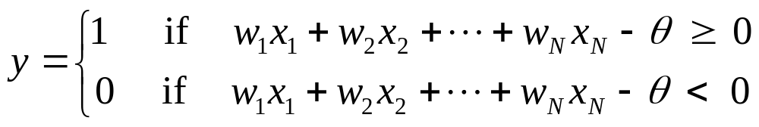

Higher Dimension Feature Space
In the case that input pattern has component more than
1 component, output of perceptron will be…
We will have decision function as
this equation is a multi dimension ( hyperplane)
In the case of input 2 dimensions, decision function
will be a line

Slide 44

Higher Dimension Feature Space (cont.)
In the case of input 3 dimensions, we will have a decision function
X₃
This equation is in 3 dimensions
Class A
Class B
X₂
X₁
Decision plane

Slide 45
Linear Separability
- In the case of a single layer perceptron we have hyperplane
as a decision function
if input pattern for each class can be separated other classes
by using hyperplane we call this data having
a linearly separable
Linearly separable
Not linearly separable
(limitation of a single layer perceptron)

Slide 46


How can we adjust weights?
considering we have a function
And would like to use a single layer perceptron to estimate this function
x₁
w₁
y
^
x₂
w₂
with output in the form
( in this case, activation function is an identity function f(x) = x )
^
We have to adjust w₁ and w₂ that makes y close
to y as close as it can.

Slide 47
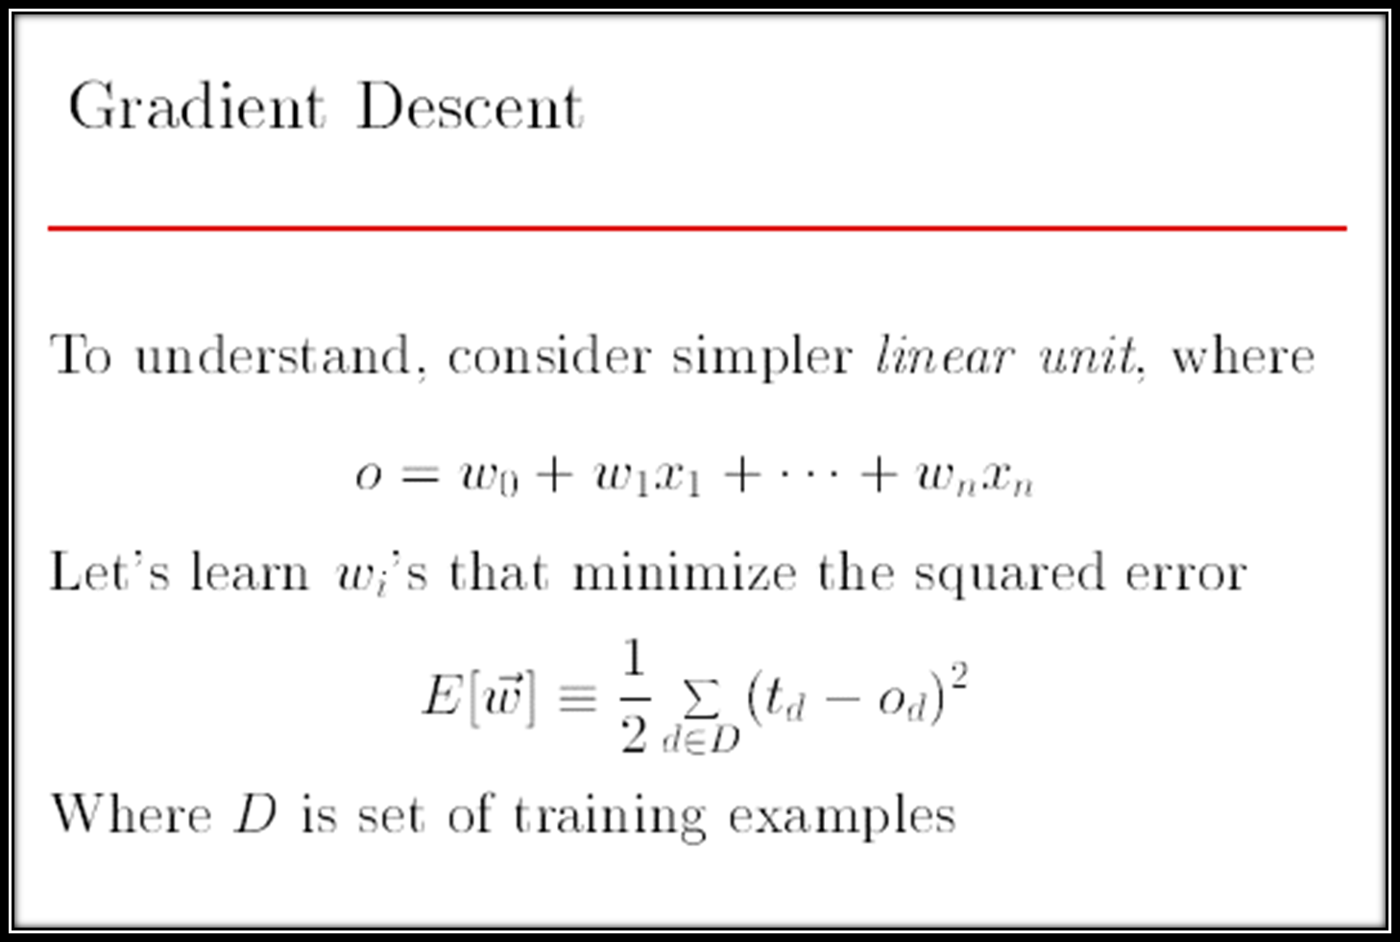

Slide 48
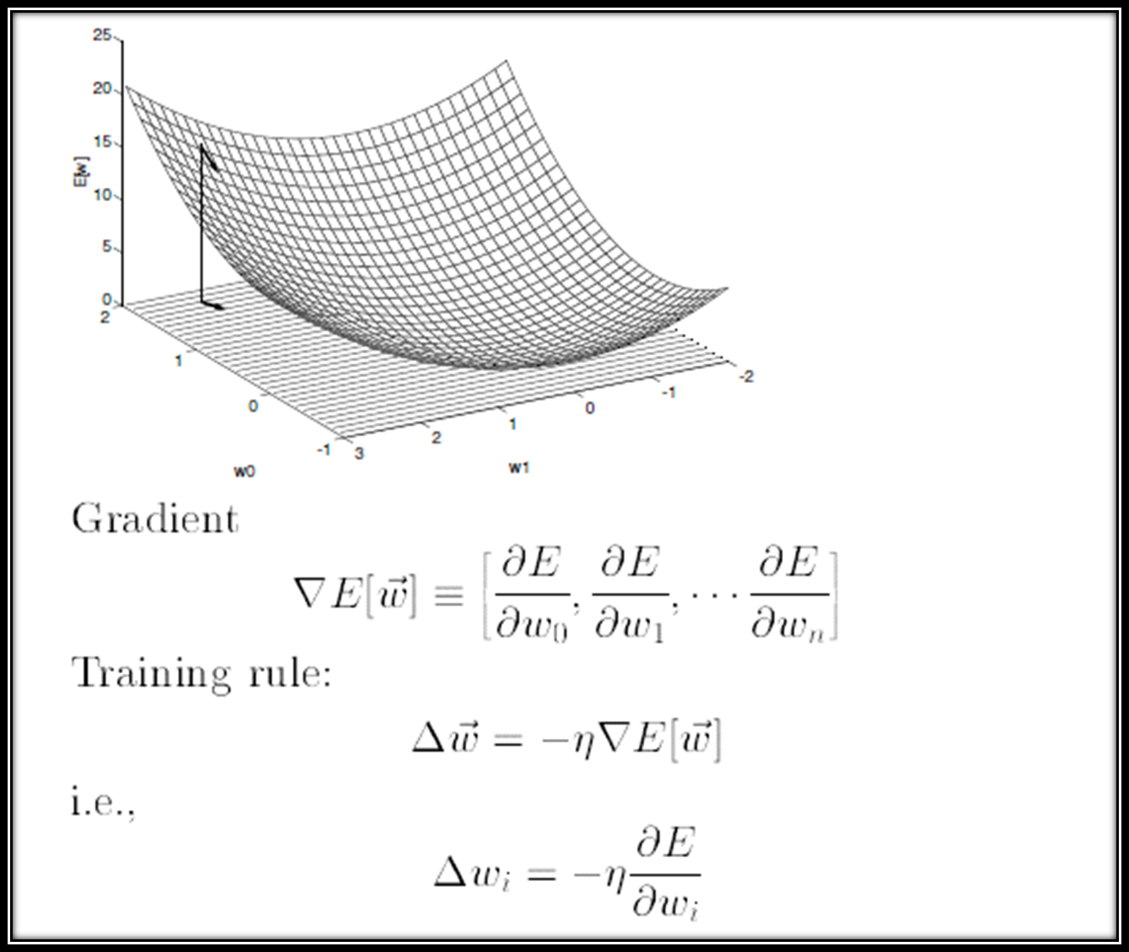
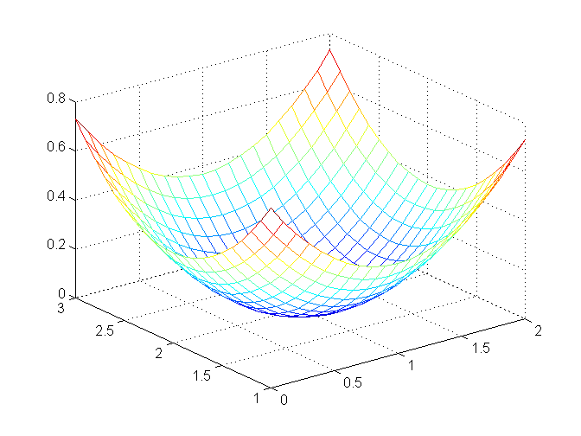
MSE
w₂
w₁

Slide 49
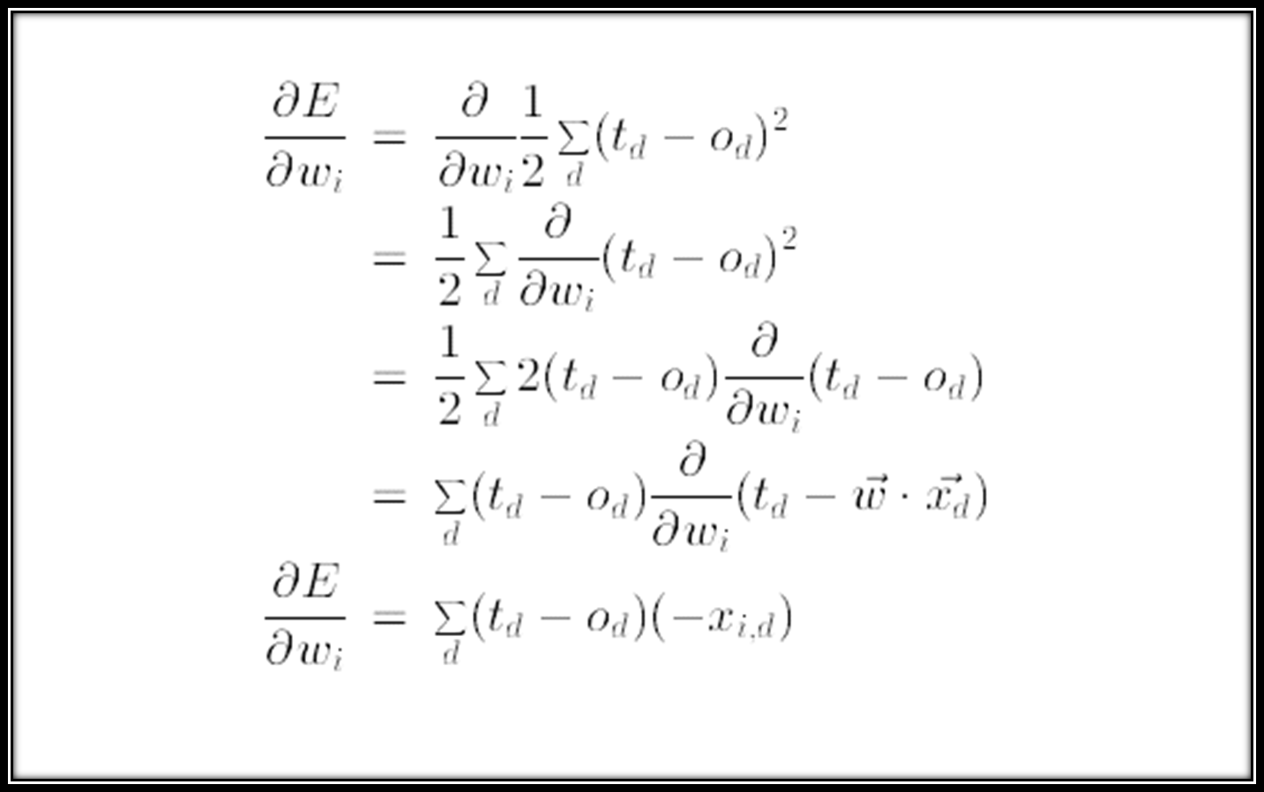

Slide 50
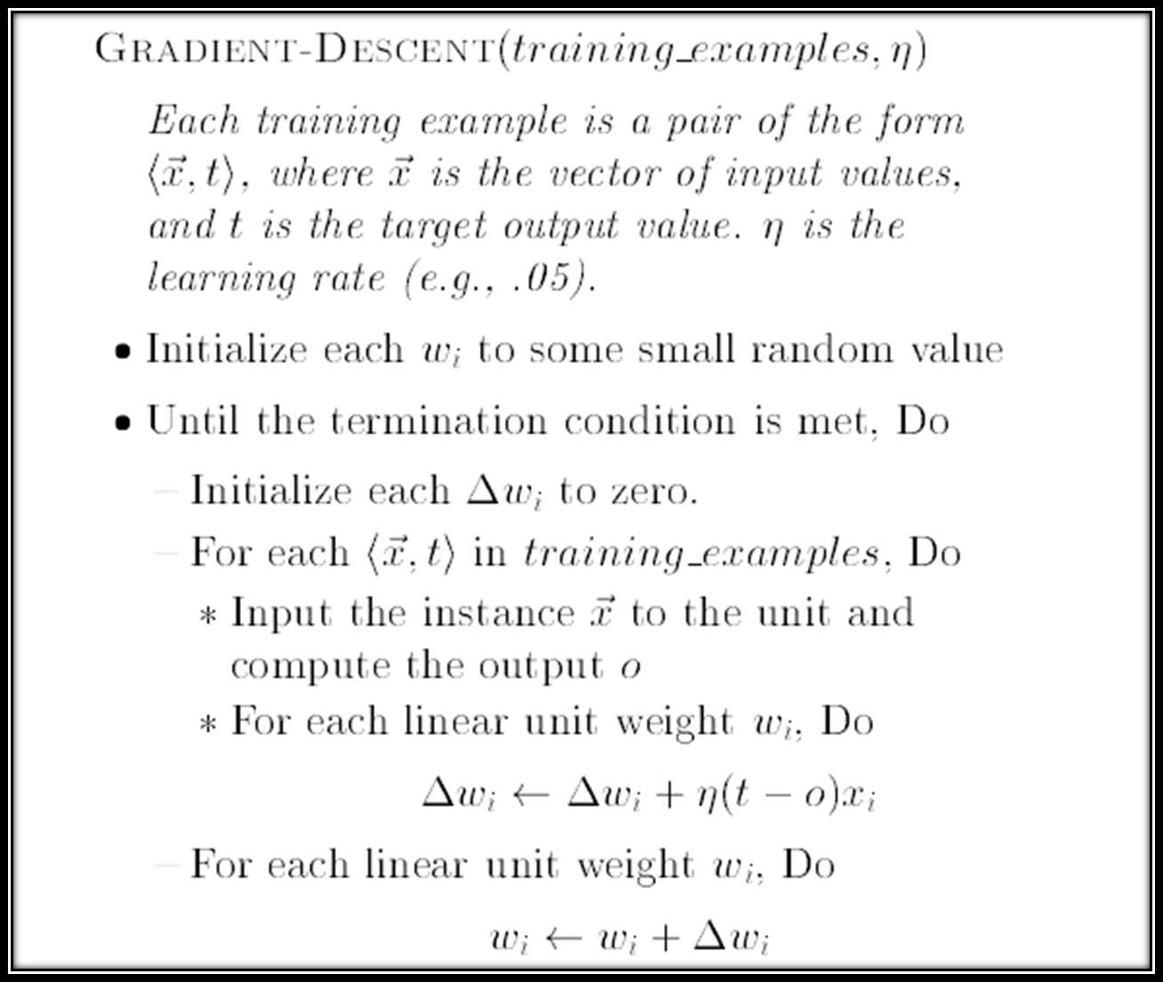

Slide 51
How can we adjust weights? (cont.)
Mean square error ε² as a function of w₁ and w₂
3
2.8
2.6
The minimum point
is at (1,2)
with MSE = 0
2.4
2.2
w₂
2
1.8
1.6
1.4
1.2
1
0
0.5
1
1.5
2
w₁
We have to adjust w₁ and w₂ to converse
to the minimum point on error surface.

Slide 52
How can we adjust weights? (cont.)
This is how adjusting w₁ and w₂ to the minimum
point on error surface.
3
Adjusting # k
2.8
goal
2.6
2.4
Adjusting # 3
2.2
w₂
Adjusting # 2
2
1.8
Adjusting # 1
1.6
1.4
Starting point
(w₁,w₂)
1.2
1
0
0.5
1
1.5
2
w₁

Slide 53
Gradient Descent Method
We want to adjust w₁ and w₂ to converse to the
minimum point of error surface.
In this situation, we can set the problem as follow
Questions
Error surface is a valley which has a blinded man
stand on the top
Having a pool on the bottom
This man want to walk to the pool
He know only the slope of the floor he stand
The question is how this man walk to the pool
Answer
Walk to direction that the steepest slope down to the pool

Slide 54
Gradient Descent Method (cont.)
Moving down the hill in the direction
that has the highest slope is called
Gradient Descent Method
compute gradient of the error
surface on the current position
(w₁,w₂)
gradient will point the highest
slope to the top of the hill
2. Move to the opposite direction
of gradient for a short distance
(by adjusting w₁,w₂)
3. Go to step 1 until reach
the minimum point

Slide 55
Weak point of Gradient Descent Method
The gradient descent method may get
struck at local minima which is not
the real minimum point
Local minimum
Global minimum

Slide 56
Why we need to adjust weight using a small step
Adjusting # 3
Adjusting # 1
adjusting weight by using
high learning rate, it will
make network slowly
converse to a minimum
point and unstable
3
2.8
2.6
2.4
2.2
w₂
2
1.8
Starting point of (w₁,w₂)
1.6
1.4
1.2
Adjusting # 2
1
0
0.5
1
1.5
2
w₁
Adjusting # k
goal

Slide 57
Why we need to adjust weight using a small step (cont.)
3
Adjusting # k
2.8
2.6
Adjusting # 3
2.4
Adjusting # 2
2.2
w₂
Adjusting # 1
2
1.8
Starting for (w₁,w₂)
1.6
1.4
1.2
1
0
0.5
1
1.5
2
w₁
adjusting weight a little by little
It makes network adjusting to
the minimum point better and
reducing unstable
goal

Slide 58
Adjusting Weights for a Nonlinear Unit (cont.)
1.2
f(x)
1
Sigmoid
function
(β = 1)
0.8
0.6
0.4
0.2
f ´(x)
0
-0.2
-5
-4
-3
-2
-1
0
1
2
3
4
5
f(x)
1
tanh
function
(β = 1)
0.6
0.2
f ´(x)
0
-0.2
-0.6
-1
-5
-4
-3
-2
-1
0
1
2
3
4
5

Slide 59
How difficult the data for the network to learn
Class B
Class B
Not OK
Class A
OK
Class A
easy
difficult
OK
The difficulty of training process depends on the distance between data groups of each class (the more they depart the more easy, the more they close, the more difficult to train)

Slide 60
Classification Performance : How good the network has learnt
Class B
Class B
d_{min}
d_{min}
Decision
plane
Class A
Class A
good
bad
Decision
plane
performance of neural network in classify class
can see from the minimum distance from input pattern
to decision plane

Slide 61
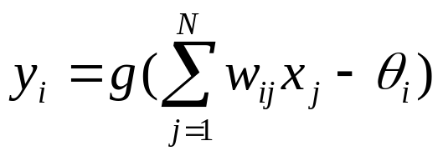
Conclusions: single layer percentron networks
Function for each unit is in a form of function of input
weighted sum
2. In the case of classifying data, Decision function will be
in a form of Hyperplane
3. Limitation of a single layer network is data have to be
linearly separable data
4. Training a neural net is done by adjusting the weight
by the way of gradient descent method for decreasing
the error as low as possible
5. Gradient descent method has a weakness in highly
possible get stuck in local minima of error surface

Slide 62
Chapter 3
Multilayer Feedforward Networks

Slide 63
Multilayer Feedforward Network Structure
Layer N
Output nodes
Layer N-1
Layer 1
Hidden nodes
Connections
Layer 0
Input nodes
N-layer network

Slide 64
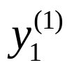
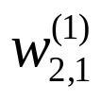
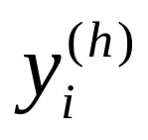
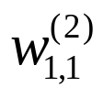
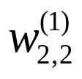
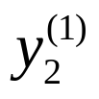
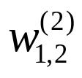
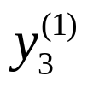
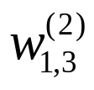
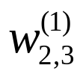
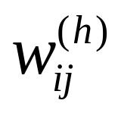
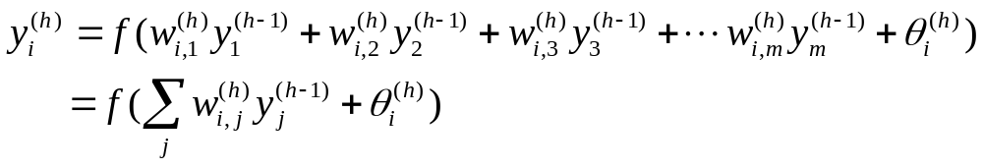
Multilayer Feedforward Network Structure (cont.)
Input node
h = layer no.
Hidden node
x₁
Output node
i = node i of layer h
x₂
o₁
h = layer no.
x₃
i = node i of layer h
j = node j of layer h-1
Output for each node
In which

Slide 65
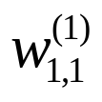
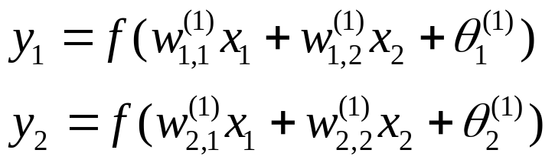
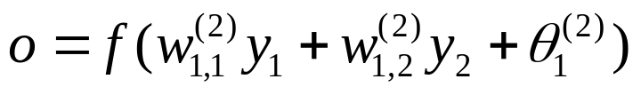
Multilayer Perceptron : How it works
Function XOR
y₁
x₁ | x₂ | y
0 | 0 | 0
0 | 1 | 1
1 | 0 | 1
1 | 1 | 0
x₁
o
x₂
y₂
Layer 1
Layer 2
f( ) = step function

Slide 66
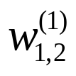
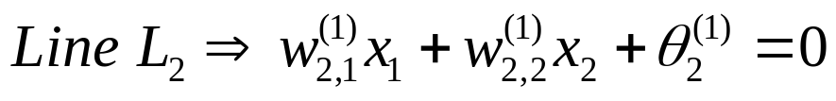
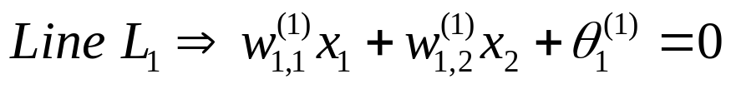
Multilayer Perceptron : How it works (cont.)
Outputs at layer 1
x₂
(1,1)
x₁ | x₂ | y₁ | y₂
0 | 0 | 0 | 0
0 | 1 | 1 | 0
1 | 0 | 1 | 0
1 | 1 | 1 | 1
x₁
y₁
(0,1)
x₂
y₂
x₁
(0,0)
(1,0)

Slide 67
Multilayer Perceptron : How it works (cont.)
Inside layer 1
x₁-x₂ space
y₁-y₂ space
x₂
y₂
(1,1)
(1,1)
(0,1)
Linearly
separable !
x₁
y₁
(0,0)
(1,0)
(0,0)
(1,0)
Class 0
Class 1

Slide 68
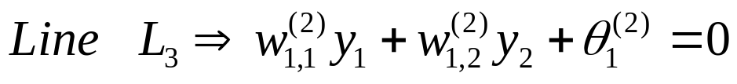
Multilayer Perceptron : How it works (cont.)
Inside output layer
y₁
Class 1
o
Class 0
y₂
y₁-y₂ space
y₂
(1,1)
Space y₁-y₂ is linearly separable
So, we can use line L₃ separate
class 0 and class 1
y₁
(0,0)
(1,0)

Slide 69
Multilayer Perceptron : How it works (cont.)
hidden layers
try to converse incoming data in that layer to be
linearly separable before send to the output layer
at the final step at Hidden layer, data have to be
linearly separable
maybe we need hidden layer more than 1 layer to
be able to converse into the form of linearly separable
each Activation function for each layer don’t need to be
Thresholding function and the same function

Slide 70
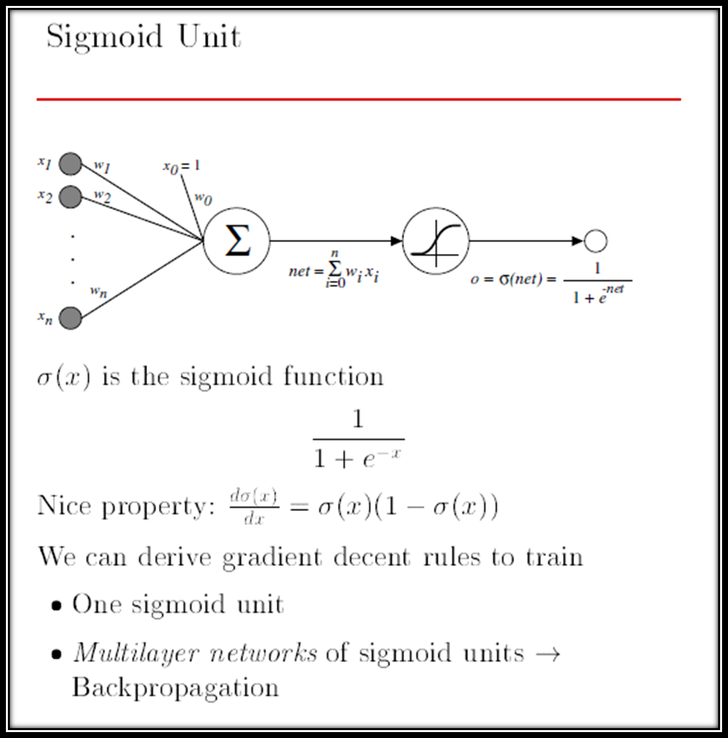

Slide 71
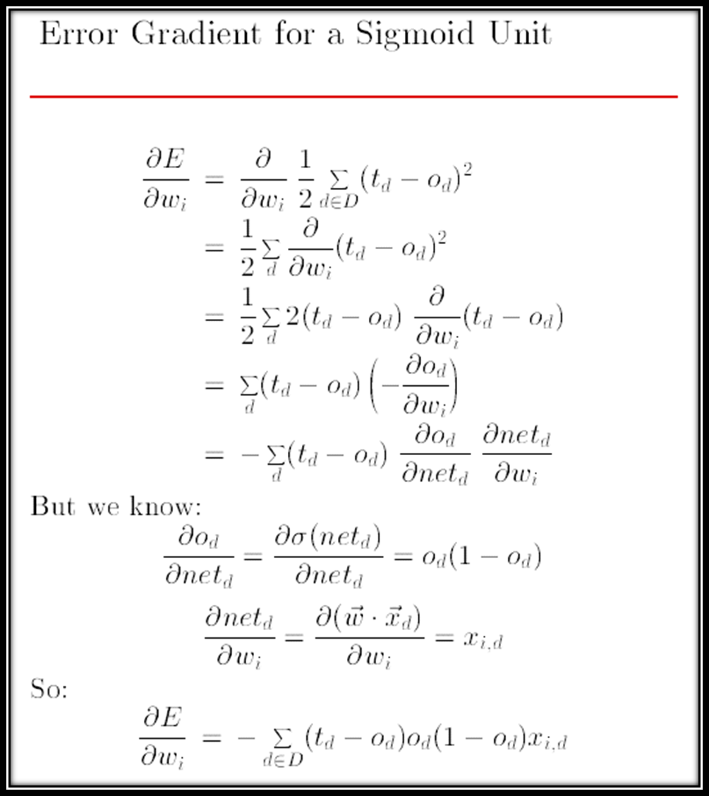

Slide 72
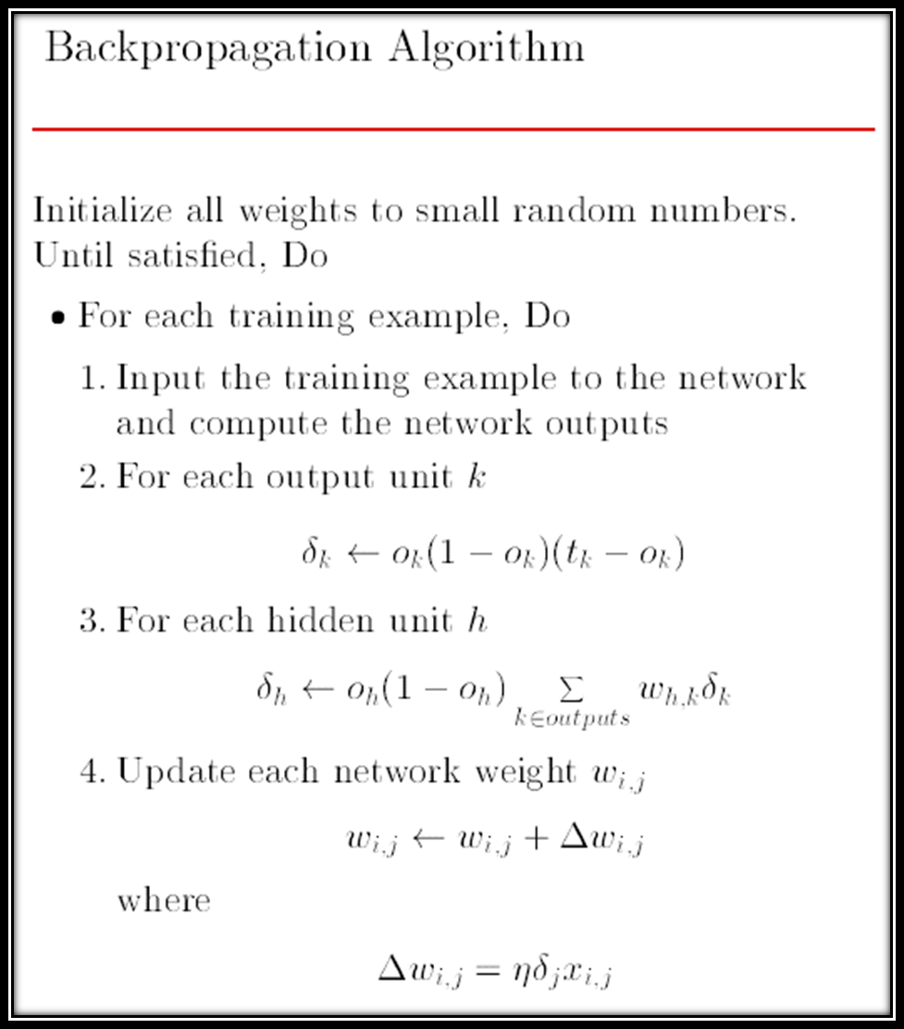

Slide 73
Backpropagation Algorithm
For each < x, t > in training sets, do
  Propagate the input forward through the network:
    Input the instance x to the network and compute the output o_{u} of every unit u in the network
  Propagate the errors backward through the network:
    For each network output unit k, calculate its error term δ_{k}
        δ_{k} ← o_{k} (1- o_{k}) (t_{k} - o_{k})
    For each hidden unit h, calculate its error term δ _{h}
    δ_{h} ← o_{h} (1- o_{h}) Σ ω_{kh} δ _{k}
    Update each network weight ω_{ji}
        ω_{ji} ← ω_{ji} + Δω_{ji}(n)
    Where
        Δω_{ji}(n) = β δ_{j} x_{ji} + αΔω_{ji}(n-1)
_{k∈ Outputs}
Weight from unit i to unit j
Input from unit i to unit j
Momentum
Learning Rate

Slide 74
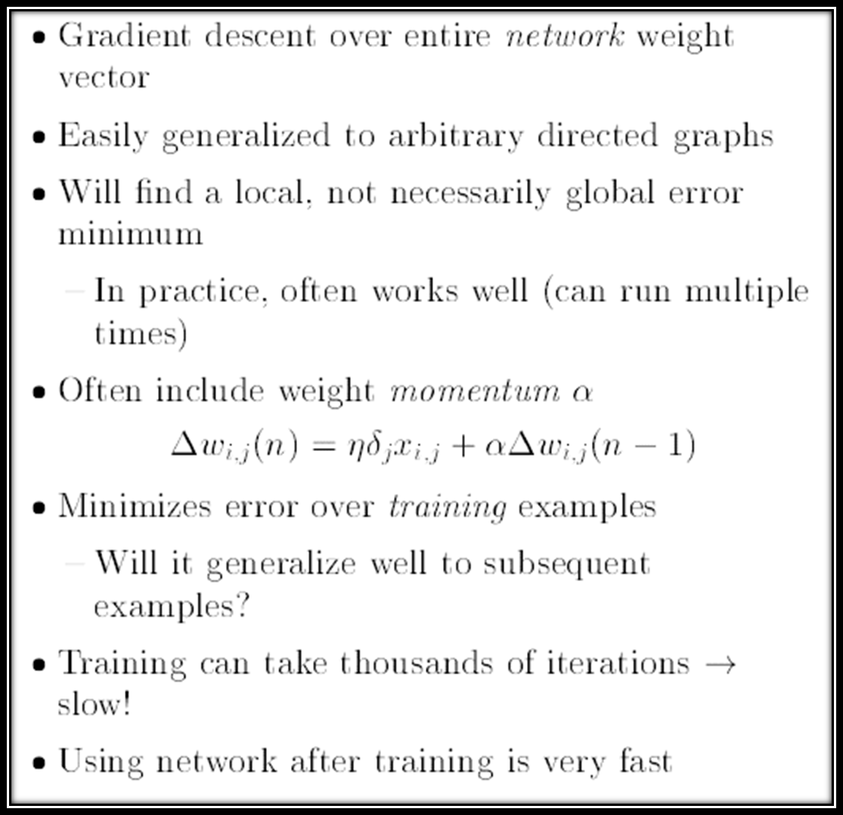

Slide 75


Slide 76


Slide 77




Slide 78


Slide 79


Slide 80


